Slide 1
20181217
Tungsten Tip Etching
-paper review-
Lee Jong Geon

Slide 2
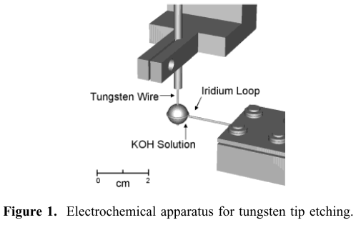
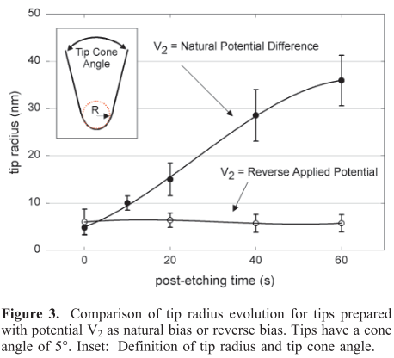
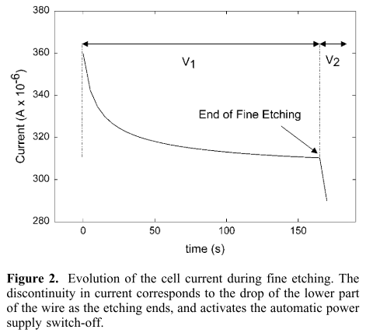
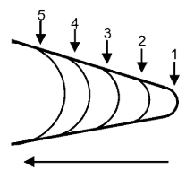
2002-Nano Letters-2,3-Reproducible Electrochemical Etching of Tungsten Probe Tips (Olivier L. Guise, Joachim W. Ahner, Moon-Chul Jung, Peter C. Goughnour, and John T. Yates, Jr.)
Post-etching: wire가 끊어진 이후에도 etching process를 진행하는 것
Switch: 500 ns
Two step etching
Coarse etching: 2M KOH, DC 3V
post etching: 0.1M KOH, DC 0.5 V
An average of at least 5 tips.
“This method produces tips in a very controlled and reproducible manner.”

Slide 3
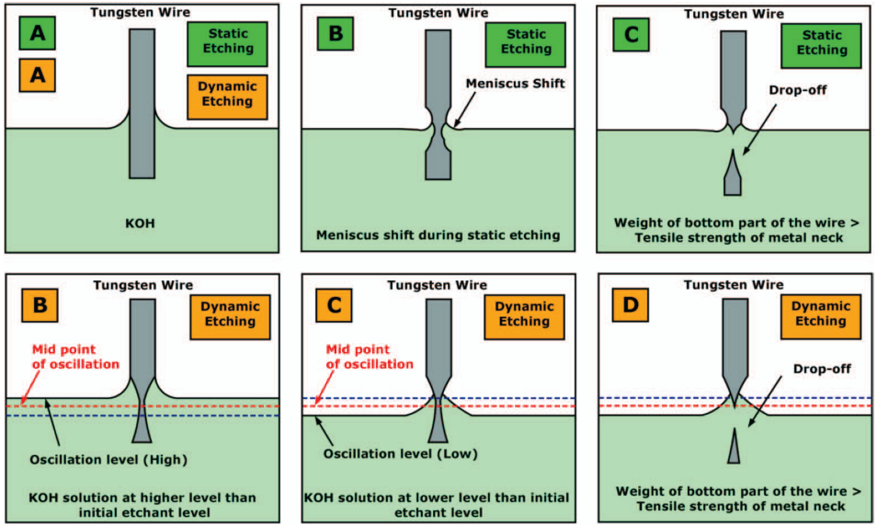
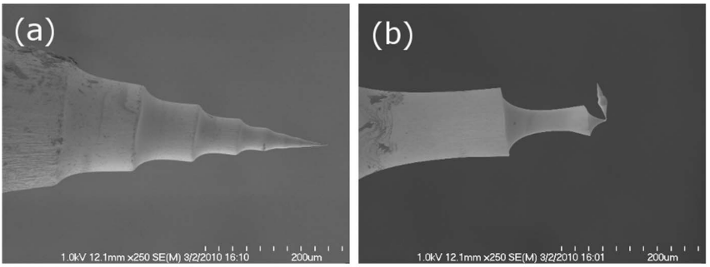
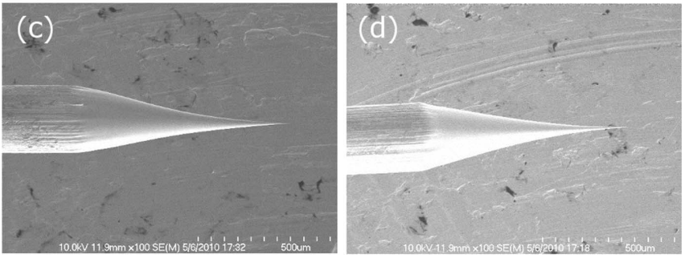
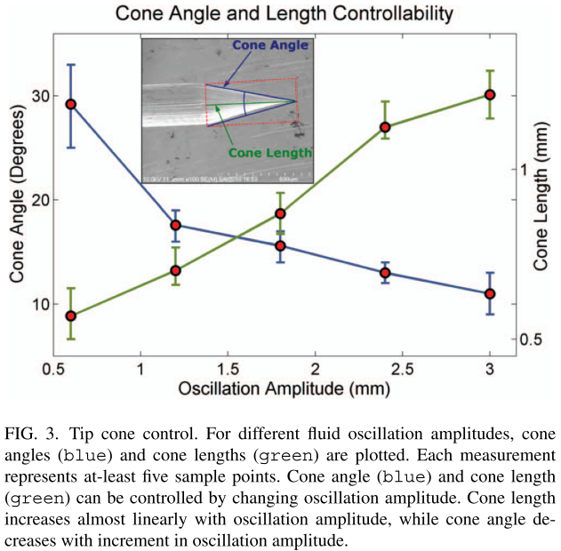
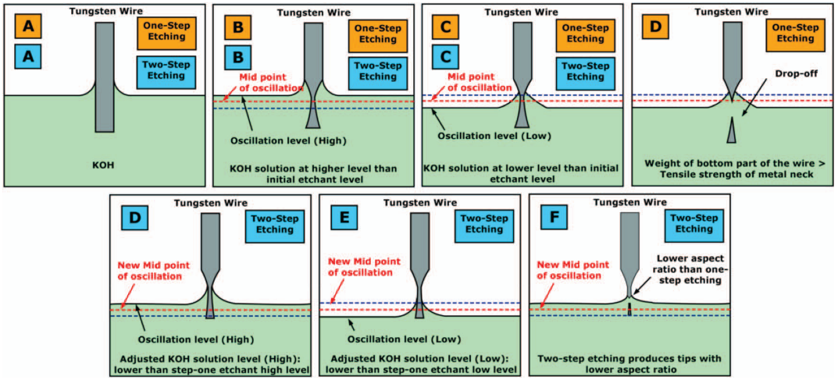
2012-Rev. Sci. Instrum.-83,6-Two step controllable electrochemical etching of tungsten scanning probe microscopy tips(Yasser Khan, Hisham Al-Falih, Yaping Zhang, Tien Khee Ng, Boon S. Ooi)
325 μm/s proved to give a stable etching voltage
One-step etching : RoC < 40 nm, ∼80% success rate
Two-step etching: RoC < 10 nm, ∼90% success rate

Slide 4
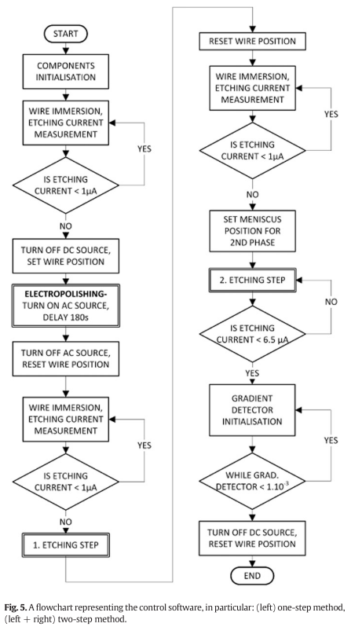
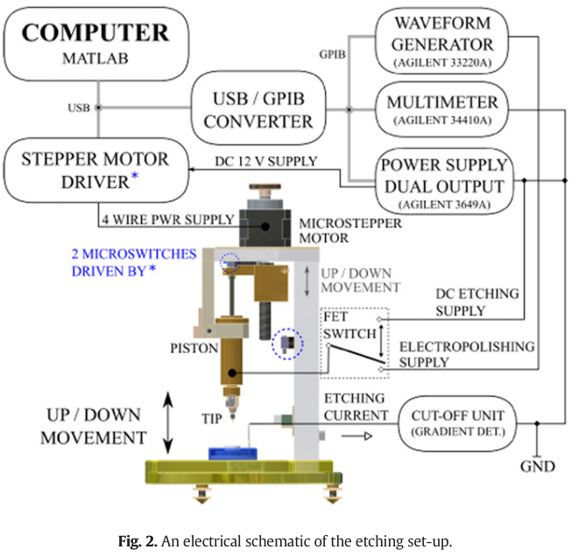
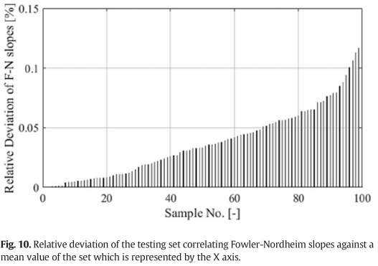
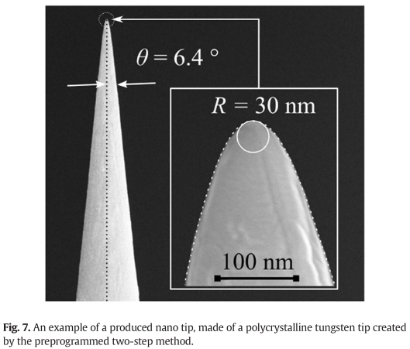
2017-Microelectronic Engineering-173-Progrmmable set-up for electrochemical preparation of STM tips and ultra-sharp field emission cathods(Alexandr Knapek, jiri Sykora, Jana Chlumska, Dinara Sobola)
etching voltage: 6.9 V
current limit: 20mA
* both the one-step and two-step
“The programming allows for increasing the reproducibility of the preparation and improves the quality of the preparation process.”

Slide 5
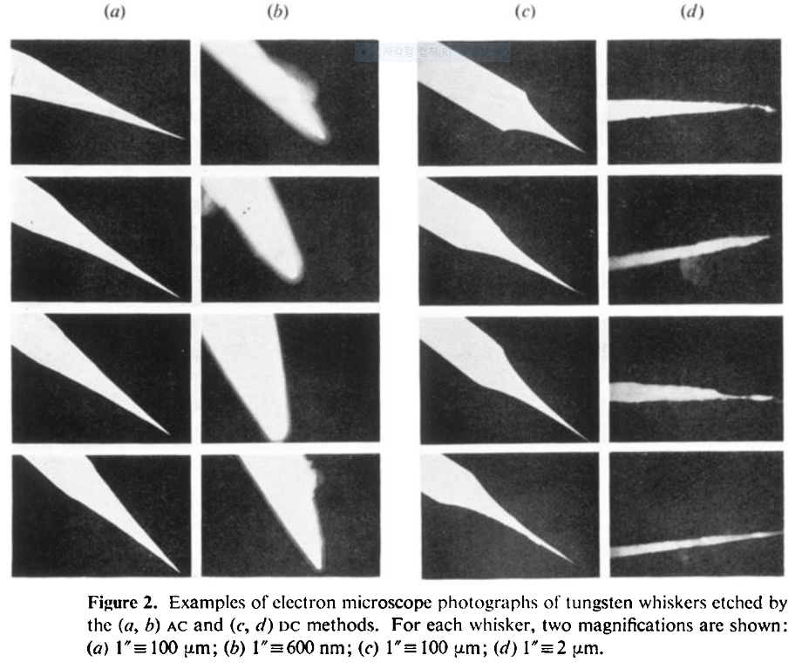
1978-J. Phys. D: Appl. Phys.-11-A comparison of AC and DC electrochemical etching techniques for the fabrication of tungsten whiskers (G. J. Edwards and P. R. Pearce)
AC
DC
Conical shape
AC etching: vigorous bubbling -> not affect the shape
DC etching: few bubbles -> irregular tip shapes

Slide 6
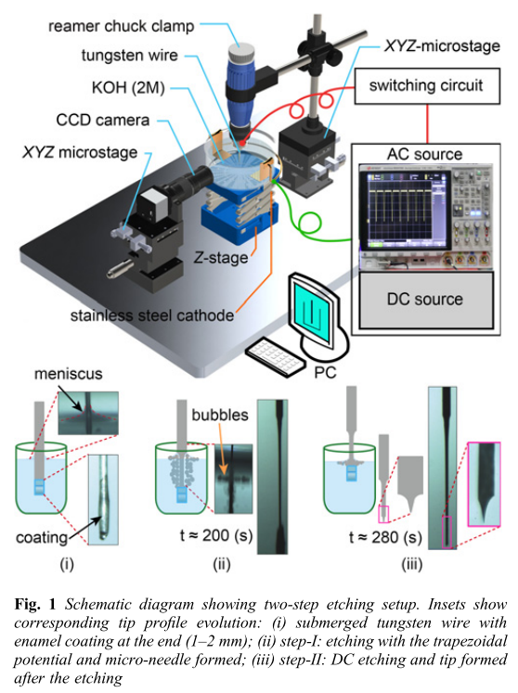
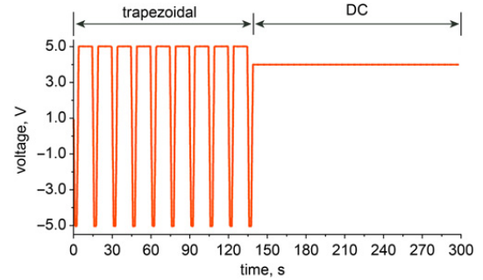
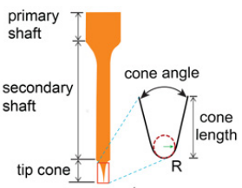
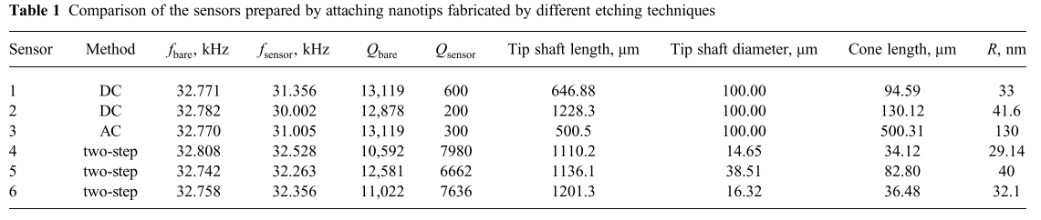
2018-Micro&Nano Letters-13,8-Electrochemical etching of lightweight nanotips for high quality-factor quartz tuning fork force sensor: atomic force microscopy applications (Danish Hussain, Jianmin Song, Hao Zhang, Xianghe meng and Hui Xie)
Two step
20 Hz
Primary shaft diameter: 10–40 μm
Length: 2–5 mm
Fabricated with high success rate (∼80%).
High Q-factor

Slide 7
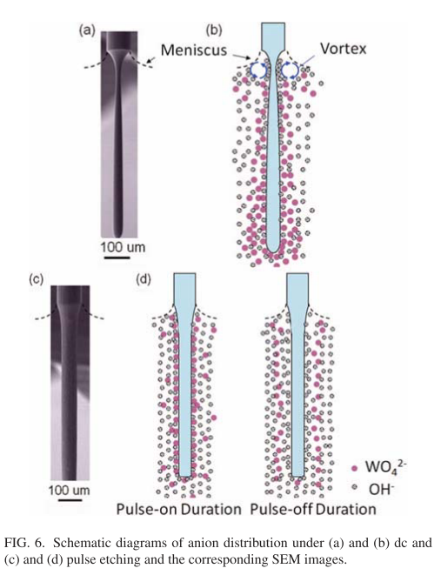
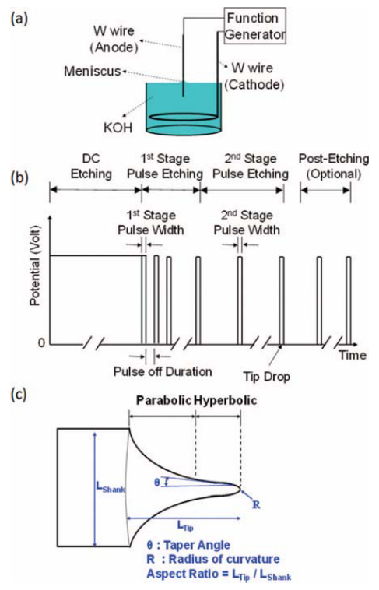
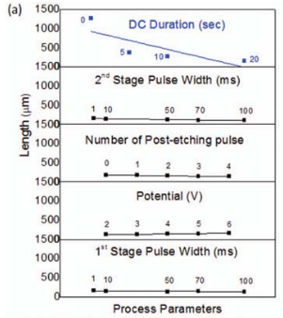
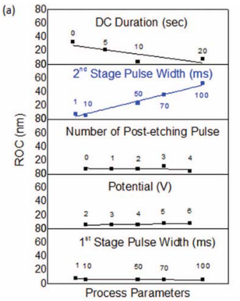
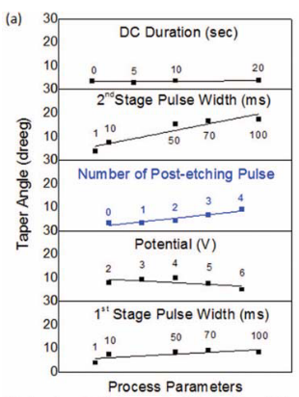
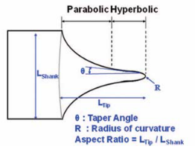
2012-Rev. Sci. Instrum.-83,08374-Method of electrochemical etching of tungsten tips with controllable profiles(Wei-Tse Chang, Ing-Shouh Hwang, Mu-Tung Chang, Chung-Yueh Lin, Wei-Hao Hsu and Jin-Long Hou)
DC(uniform)
etching
10M
Pulse
etching
“we propose a simple and reliable electrochemical method to fabricate tungsten tips with good control of the tip profile.”

Slide 8
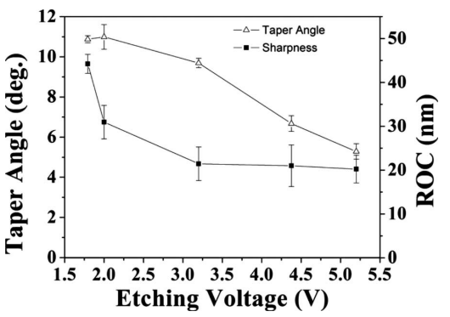
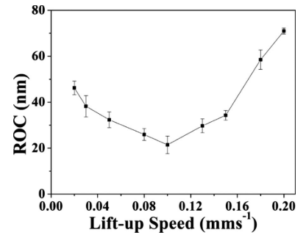
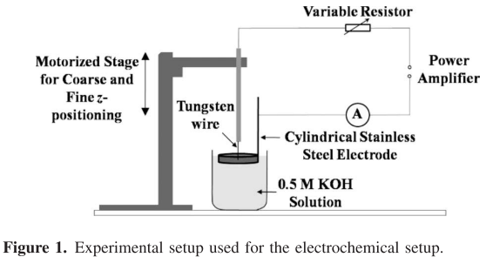
2010-Journal of The Electrochemical Society-157,1-Optimization of AC Electrochemical etching for Fabricating Tungsten Nanotips with Controlled Tip Profile (S. L. Toh, H. Tan, J. C. Lam, C. Hsia, Z. H. Mai)
AC power supply: 13.5 V, 50 Hz
-> variable resistor selected(1.8 ~ 5.2 V)
0.5 M KOH
0.5 M KOH, 3.2 V

